Slide 1
Reflection at a Straight Boundary

Slide 2
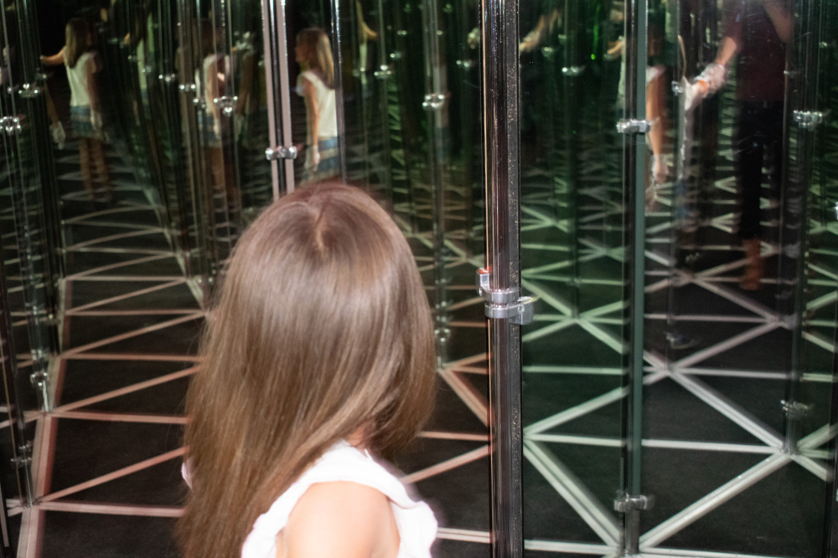
By the end of this lesson, you should be able to:
State the law of reflection.
Determine angles of incidence and reflection from a plane mirror.
Explain the difference between regular and diffuse reflection.

Slide 3
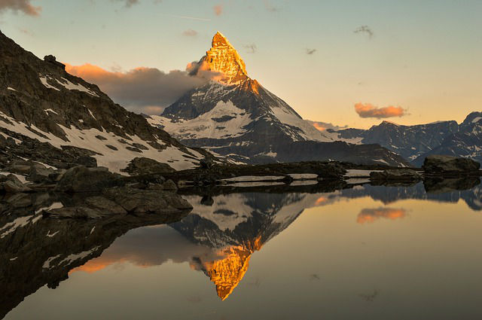
Reflection is more important than you might think.
It’s obvious that mirrors can reflect light to produce a clear image of something, but there’s more to it than that. The reflection of light is what allows you to see anything that doesn’t emit its own light.
Light bounces off everything around you, and your eyes detect this and interpret it into everything you can see.

Slide 4
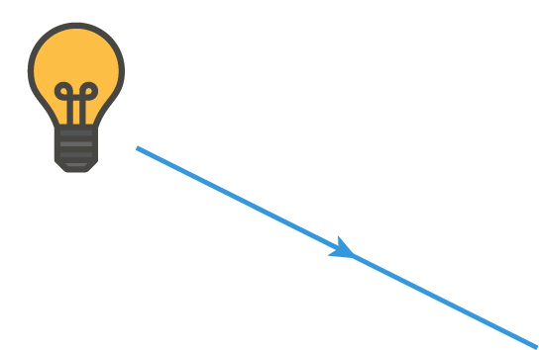
The ray model of light can be used to model the behaviour of light as if it travels in straight lines.
A ray diagram is a drawing which shows the path of individual rays of light which are relevant to a particular situation. The ray is represented by a straight line, with an arrow in the direction of movement in the centre of its length.

Slide 5
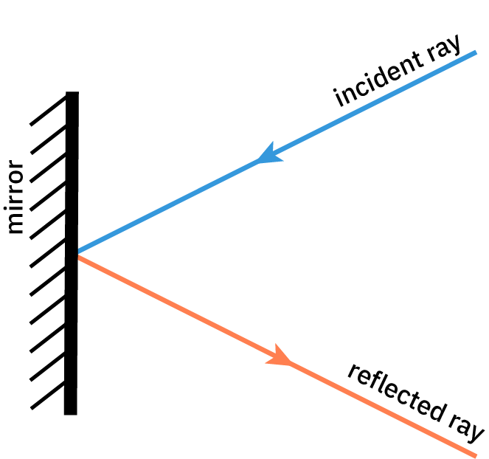
Let’s look at how ray diagrams work with a plane mirror.
Plane mirrors are mirrors that have flat surfaces. You probably encounter this type of mirror quite often, for example on your bathroom wall. Other flat, reflective surfaces such as a sheet of metal or the surface of a still pond can also be approximated as plane mirrors.
When a ray of light approaches the mirror, it is reflected from it. The ray of light coming towards the mirror is called the incident ray. The ray which leaves the mirror after being reflected is called the reflected ray.

Slide 6
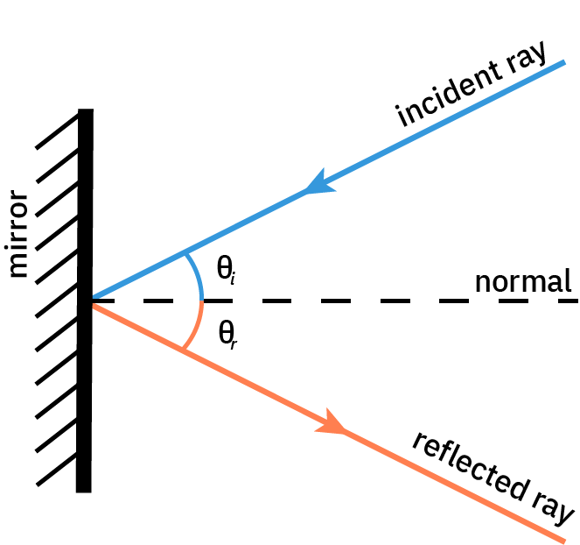
At the point where the incident ray touches the mirror, we draw an imaginary line.
This line comes out of the mirror at right angles (perpendicular) to it. It is called the normal, and is drawn as a dashed line. The normal will help us identify how reflection occurs.
The angle between the incident ray and the normal is called the angle of incidence (θ_{i​}). The angle between the reflected ray and the normal is called the angle of reflection (θ_{r}​).

Slide 7
As we study the relationship between the normal and the rays of light, we notice some interesting things.
The angle of incidence is always less than 90∘, because otherwise the light ray wouldn’t hit the mirror.
The angle of incidence is always equal to the angle of reflection (θ_{i​}=θ_{r​}). Whatever the angle the light strikes the mirror at (relative to the normal), it will reflect from it at the same angle. This is the law of reflection.

Slide 8
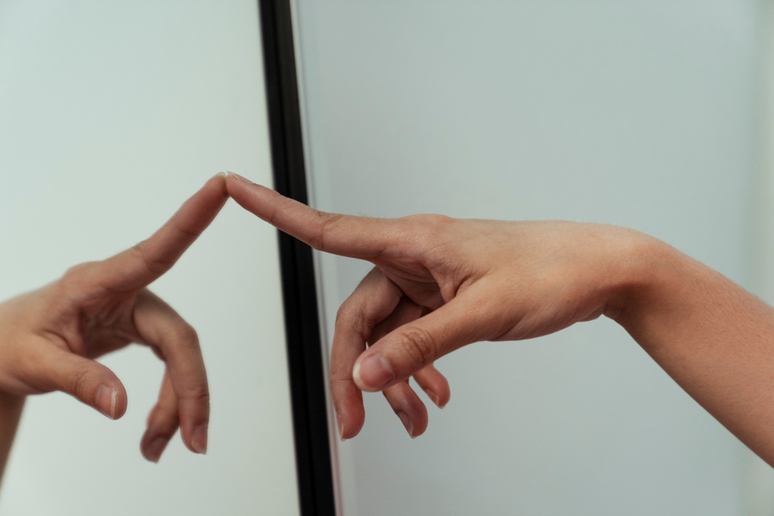
All this explains how mirrors are reflective, but it doesn’t explain how they fool your eye.
The image you see in a mirror appears reversed, and the same distance behind the mirror as the object is in front. This is a virtual image⁠—there’s nothing really there behind the mirror, as you can see if you look behind it.
Mirrors reverse things along the normal. The point on an object closest to the mirror surface in the real world is also closest to it in the reflection, and the rest of the object’s reflection extends back into the mirror away from it. We think of mirrors as flipping things left-to-right, but this is an illusion because we think of these directions relative to our bodies.

Slide 9
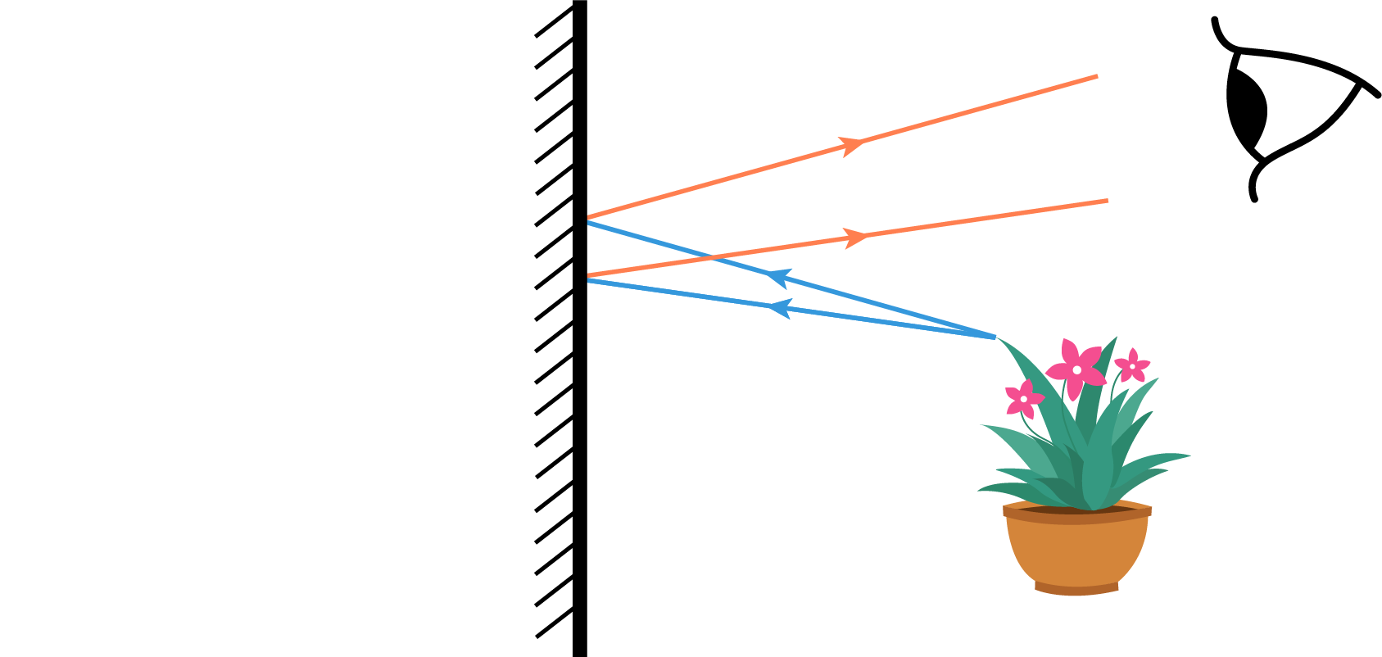
Light rays reflect from an object in all directions, but we only draw the ones that are relevant.
Picture two rays of light reflecting from the same point on an object at slightly different angles. Images are formed where reflected rays converge. At the point where the rays meet, you will see an image of the object.
These rays come from the object, reflect from the mirror, and reach your eyes. But in the diagram below, you can see that they don’t converge at the mirror. So where is the image?

Slide 10
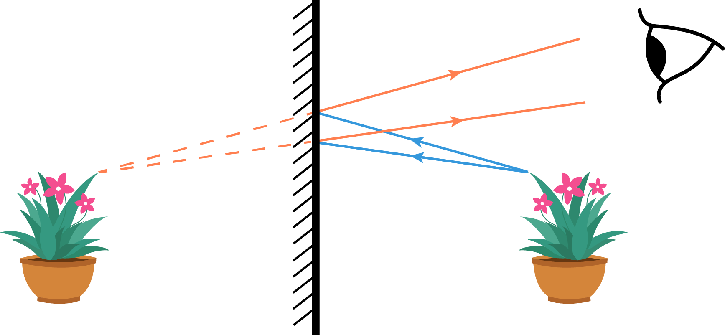
To find the image, we have to trace the rays backwards.
Your eyes can’t detect that the light rays have reflected from the mirror, so instead they trace the light back to where it appears to have come from. It’s not possible for light to actually travel behind the mirror, so we refer to these imaginary rays as virtual rays.
Following the virtual rays (dashed lines), we see that the rays appear to converge behind the mirror, the same distance behind the mirror as the object is in front. This, then, is where you see the object.

Slide 11
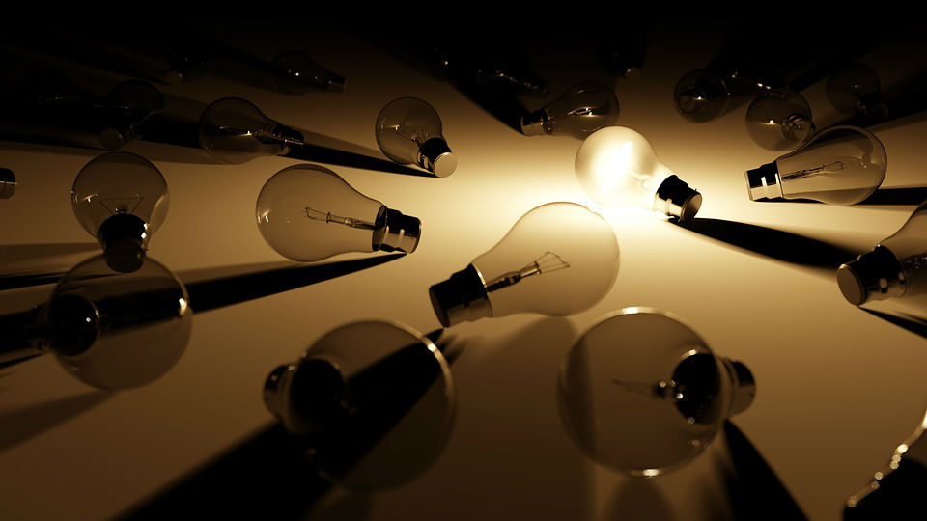
In terms of light, there are two main classes of objects in the world: luminous and non-luminous.
Luminous objects emit their own light. This allows us to see them, and also allows us to see other objects. The Sun is a luminous object; so is a lit torch or lightbulb, and the screen you’re doing this lesson on.
Non-luminous objects can only be seen when light from a luminous object falls on them. The light is reflected from them and enters our eyes, enabling us to see. This is why we can’t see in the dark⁠—there’s not enough light to reflect.

Slide 12

We see colours due to the reflection and absorption of light.
Sunlight is made up of most of the electromagnetic spectrum. When light hits an object, the object selectively absorbs or reflects different wavelengths due to the properties of the atoms that make it up.
The wavelengths of light that are reflected reach our eyes and determine the colour we see. Black objects absorb all visible wavelengths, while white objects reflect them all. An object that is red reflects red light and absorbs all other wavelengths.

Slide 13

Regular (also known as specular) reflection happens when light strikes a smooth surface.
It results in shiny surfaces, such as you see in mirrors, metal or glass. Regular reflection doesn’t always have to involve plane surfaces (you will learn about curved mirrors later).
But not all surfaces are shiny like this. What happens when light reflects off an object which is not shiny?

Slide 14

Diffuse reflection happens when light reflects from a rough surface.
In this case, the law of reflection still applies, and we can still draw a normal line perpendicular to the surface where the ray strikes it and determine the angle of reflection.
However, as the surface is irregular, the normal line at each point on the surface will have a different angle. Each incident ray will reflect in a different direction, so the light that is reflected from the surface will be spread out (diffuse) overall.

Slide 15
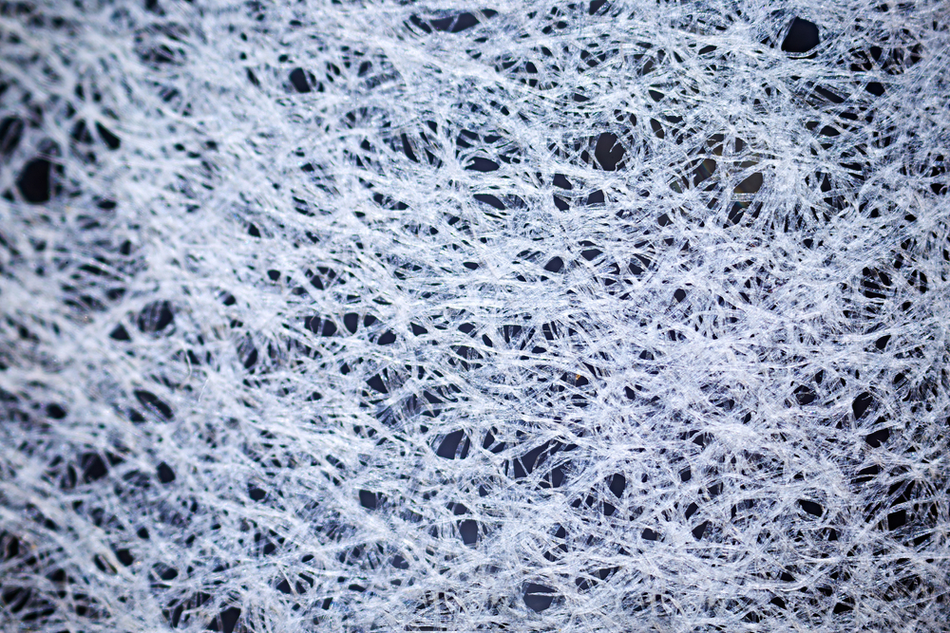
But what about the surfaces that aren’t shiny or obviously rough?
Many surfaces are rough at the microscopic level, even if they don’t look it to the naked eye. Paper, for example, seems quite smooth, but under a microscope, or even a magnifying glass, the surface is irregular. Thus, it casts diffuse reflections and is not shiny—it looks dull.

